Slide 1

CS411-Compiler Construction
Bottom Up Parsing
-Shift Reduce Parsing
Talha Waheed, Dept. of CS, UET, Lahore, Pakistan.

Slide 2
Course Learning Objectives

Slide 3
Bottom-Up Parsing
A bottom-up parser corresponds to the construction of a parse tree for an input string beginning at the leaves (the bottom) and working up towards the root (the top).
It is convenient to describe parsing as the process of building parse trees, (although a front end may in fact carry out a translation directly without building an explicit tree).

Slide 4
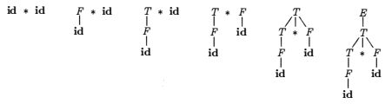
Bottom-Up Parsing - Example
Grammar
E → E + T (1.1) | T (1.2) T → T * F (2.1) | F (2.2) F → (E) (3.1) | id (3.2)
Input: id * id
Reduce (match) with right side of some production and replace with its left side non-terminal
id * id
(3.2) ⇒ F * id
(2.2) ⇒ T * id
(1.2 or 3.2?) ⇒ T * F
(2.1) ⇒ T
(1.2) ⇒ E (Accepted!)
Note that the above reduction is exactly reverse to following rightmost derivation. E ⇒ T ⇒ T * F ⇒ T * id ⇒ F * id ⇒ id * id
Step by step parse tree construction for input id*id from leaves to root is also presented.

Slide 5
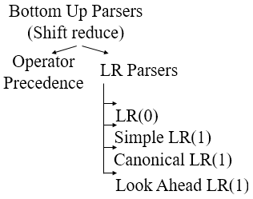
Bottom-Up Parsing
A general style of bottom-up parsing is known as shift-reduce parsing.
An easy-to-imp1ement form of shift-reduce parsing is called operator-precedence parsing, not suitable for all kind of grammars.
A much more general and the largest class of grammars for which shift-reduce parsing can be built is called LR parsing.
Too much work to build an LR parser by hand, however automatic parser generators make it easy to construct efficient LR parsers from suitable grammars

Slide 6
Shift-Reduce Parsing
Shift-reduce parsing also attempts to construct a parse tree for an input string beginning at the leaves (bottom) and working up towards the root (top).
We can think of this process as one of "reducing" a string w to the start symbol of a grammar.
At each reduction step a particular substring matching the right side of a production is replaced by the non-terminal on the left of that production.
The key decisions as during bottom-up parsing proceeds are
about when to reduce and
about what production to apply.
If the substring is chosen correctly at each step during a left-to-right scan, a rightmost derivation is traced out in reverse.

Slide 7
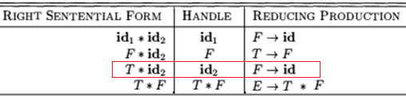
Informal Definition of Handle in Handle Pruning
A rightmost derivation in reverse can be obtained by "handle pruning”.
A "handle" is a substring that matches the body of a production, and whose reduction represents one step along the reverse of a rightmost derivation.
(E.g. adding subscripts to the tokens id for clarity), the handles during the parse of id₁ * id₂ according to the given grammar are as in following Fig. Grammar: E → E + T (1.1) | T (1.2) T → T * F (2.1) | F (2.2) F → (E) (3.1) | id (3.2)
T is the body of production E → T (1.2), but it is not a handle in the sentential form T * id₂.
If T were reduced by E, the string T * id₂ becomes E * id₂, which cannot be derived from the start symbol E.
Thus, the leftmost substring that matches the body of some production need not be a handle.

Slide 8
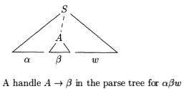
Formal Definition of Handle 1/2
Formally, if S ⇒ αAw ⇒ αβw, as in Fig, then production A → β in the position following α is a handle of αβw.
Alternatively, a handle of a right-sentential form γ is a production A → β and a position of γ where the string β may be found, such that replacing β at that position by A produces the previous right-sentential form in a rightmost derivation of γ.
Notice that the string w to the right of the handle must contain only terminal symbols. (For convenience, we refer to the body β (rather than A → β) as a handle.)
Note we say "a handle" rather than "the handle" because the grammar could be ambiguous, with more than one rightmost derivation of αβw.
If a grammar is unambiguous, then every right-sentential form of the grammar has exactly one handle.

Slide 9
Formal Definition of Handle 2/2
A rightmost derivation in reverse can be obtained by "handle pruning”. That is, we start with a string of terminals w to be parsed.
If w is a sentence of the grammar at hand, then let w = γ_{n}, S = γ₀ ⇒ γ₁ ⇒ γ₂ ⇒… γ_{n-1} ⇒ γ_{n} = w (where γ_{n} is the nth right-sentential form of some as yet unknown rightmost derivation)
To reconstruct this derivation in reverse order, we locate the handle β_{n} in γ_{n} and replace β_{n} by the head of relevant production A _{n} → β_{n} to obtain the previous right-sentential form γ_{n}.
Note that we do not yet know how handles are to be found, but we shall see methods of doing so shortly.
We then repeat this process. That is; we locate the handle β_{n-1} in γ_{n-1} and reduce this handle to obtain the right-sentential form γ_{n-2}.
If by continuing this process we produce a right-sentential form consisting only of the start symbol S, then we halt and announce successful completion of parsing.
The reverse of the sequence of productions used in the reductions is a rightmost derivation for the input string.

Slide 10
Shift-Reduce Parsing
A stack holds grammar symbols and an input buffer holds the string to be parsed.
Handle always appears at top of the stack just before it is identified as the handle.
We use $ to mark the bottom of the stack and also at the right end of the input $.
Conventionally, when discussing bottom-up parsing, we show top of the stack on the right (rather than on the left as we did for top-down parsing).
Initial Configuration
Initially, the stack is empty, and the string w is on the input, as follows: Stack: Input:
During a left-to-right scan of input string, parser shifts zero or more input symbols on the stack, until it is ready to reduce a string β of grammar symbols on stack top.
It then reduces β to left-side of appropriate production. Parser repeats this until
found an error or
stack contains start symbol and input is empty. (string accepted & parsing finished.)
Final Configuration
Stack: Input:
$
w | $
$ | E
$

Slide 11
Example – Shift Reduce Parsing
Given table steps through the actions a shift-reduce parser might take in parsing the input string id1 *id2 according to the following expression grammar
E → E + T (1.1) | T (1.2) T → T * F (2.1) | F (2.2) F → (E) (3.1) | id (3.2)
Stack Input Action
$ id₁ * id₂ $ Shift id₁ on stack
$id₁ * id₂ $ Reduce by F → id (3.2)
$F * id₂ $ Reduce by T → F (2.2)
$T * id₂ $ Shift * on stack
$T* id₂ $ Shift id₂ on stack
$T*id₂ $ Reduce by F → id (3.2)
$T*F $ Reduce by F → T * F (2.1)
$T $ Reduce by E → T (1.2)
$E $ Start Symbol on Stack Top, Input Finished, Accept!!
Four possible actions a shift-reduce parser can make:
Shift. Shift the next input symbol onto the top of stack.
Reduce. The right end of the string to be reduced must be at the top of the stack. Locate the left end of string within the stack and decide with what nonterminal (on left) to replace the string.
Accept. Announce successful completion of parsing.
Error. Discover a syntax error and call an error() recovery function.

Slide 12
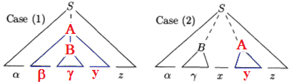
Why to Use Stack in Shift-Reduce Parsing 1/2
Fact: the handle will always eventually appear on top of the stack, never inside.
This can be shown by considering the possible forms of two successive steps in any rightmost derivation.
Above figure illustrates the two possible cases.
Case (1), A is replaced by βBy, and then rightmost nonterminal B in the body βBy is replaced by γ.
Case (2), A is again expanded first, but this time body is a string y of terminals only.
The next rightmost nonterminal B will be somewhere to the left of y. In other words
(Case 1) S ⇒ αAz ⇒ αβByz ⇒ αβγyz
(Case 2) S ⇒ αBxAz ⇒ αBxyz ⇒ αγxyz

Slide 13
Why to Use Stack in Shift-Reduce Parsing 2/2
(Case 1) in reverse, where parser reached the configuration. Stack: $αβγ Input: yz$
The parser reduces handle γ to B to reach configuration Stack: $αβB Input: yz$
The parser can now shift the string y on the stack by a sequence of zero or more shift moves to reach the configuration. Stack: $αβBy Input: z$ with the handle βBy on top of the stack and it get reduced to A. Stack: $αA Input: z$
(Case 2). In configuration, the handle γ is on top of stack Stack: $αγ Input: xyz$
After reducing the handle γ to B, configuration becomes Stack: $αB Input: xyz$
parser can shift string xy to get next handle y on stack top, ready to be reduced to A Stack: $αBxy Input: z$ will become Stack: $αBxA Input: z$
Note: In both cases, after making a reduction the parser had to shift zero or more symbols to get the next handle onto the stack. It never had to go into the stack to find the handle.

Slide 14
Conflicts During Shift-Reduce Parsing
There are some grammars for which shift-reduce parsing cannot be used.
Technically, these grammars are non-LR(k) grammars. (The k in LR(k) refers to the number of symbols of lookahead on the input).
Grammars used in compiling usually fall in the LR(1) class, with one symbol of lookahead at most.
Every shift-reduce parser for such a grammar can reach a configuration in which the parser, knowing the entire stack contents and next input symbol,
cannot decide whether to shift or to reduce (a shift/reduce conflict), or
cannot decide which one of reduction to make (reduce/reduce conflict).

Slide 15
Shift-Reduce Conflict - Example
An ambiguous grammar (like dangling else) can never be LR.
stmt → if expr then stmt (1.1) | if expr then stmt else stmt (1.2) | other (1.3)
If we have a shift-reduce parser in configuration Stack: Input: we cannot tell whether if expr then stmt is the handle, no matter what appears below it on the stack. (shift / reduce conflict).
Depending on what follows the else on the input, it might be correct
to reduce if expr then stmt (1.1) to stmt (non-terminal on left), or
to shift else and then to look for another stmt to complete the alternative if expr then stmt else stmt (1.2) to stmt (non-terminal on left).
Note that shift-reduce parsing can be adapted to parse certain ambiguous grammars, such as the dangling-else grammar above.
If we resolve the shift/reduce conflict on else in favor of shifting (1.2), the parser will behave as we expect, associating each else with the closest unmatched then. (We discuss parsers for such ambiguous grammars later).
$ | … | if | expr | then | stmt
else | … | $

Slide 16
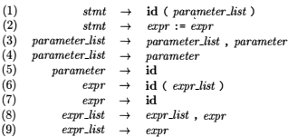
Reduce/Reduce Conflict - Example
Suppose a lexical analyzer returns the token name id for all (variable, arrays or function).
That language calls functions by giving their names, with parameters surrounded by parentheses, and that arrays are referenced by the same syntax.
Since translation of indices in array references and parameters in function calls are different, we want to use different productions to generate lists of actual parameters and indices.
Relevant grammar productions are given in following Fig.
Lexical analyzer will convert function p (i , j ) to the token stream id (id, id) for the parser.
After shifting first three tokens on the stack, a shift-reduce parser would be in configuration Stack: Input:
$ | … | id | ( | id
, | id | ) | … | $

Slide 17
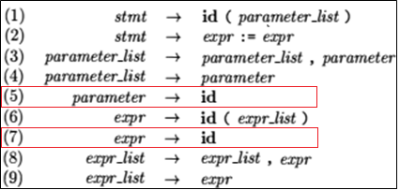
Reduce/Reduce Conflict - Example
Stack: Input:
id on top of the stack must be reduced, but by which production?
production (5, parameter → id) if p is a function or production (7, expr → id) if p is an array.
Stack doesn’t guide us for this; information in symbol table obtained from the declaration of p must be used.
Solution
lexical analyzer will produce procid in production (1) instead of id when it recognizes a function.
lexical analyzer may consult symbol table for this token.
If we made this modification, then parser would reduce to
production (5) for configuration Stack: Input:
production (7) for configuration Stack: Input:
Notice how the 3rd symbol from top of the stack (procid or id) determines the reduction to be made, even though it is not involved in the reduction.
Shift-reduce parsing can utilize information far down in the stack to guide the parse, by looking k symbols ahead.
$ | … | id | ( | id
, | id | ) | … | $
$ | … | procid | ( | id
, | id | ) | … | $
$ | … | id | ( | id
, | id | ) | … | $

